Slide 1
ML : Explainability
Sanjit Paliwal

Slide 2
Agenda
Model Agnostic Explainability Landscape
LIME
Intro
Process
SHAP
Shapley Values
SHapley Additive Explanations
Kernel SHAP
Demo

Slide 3
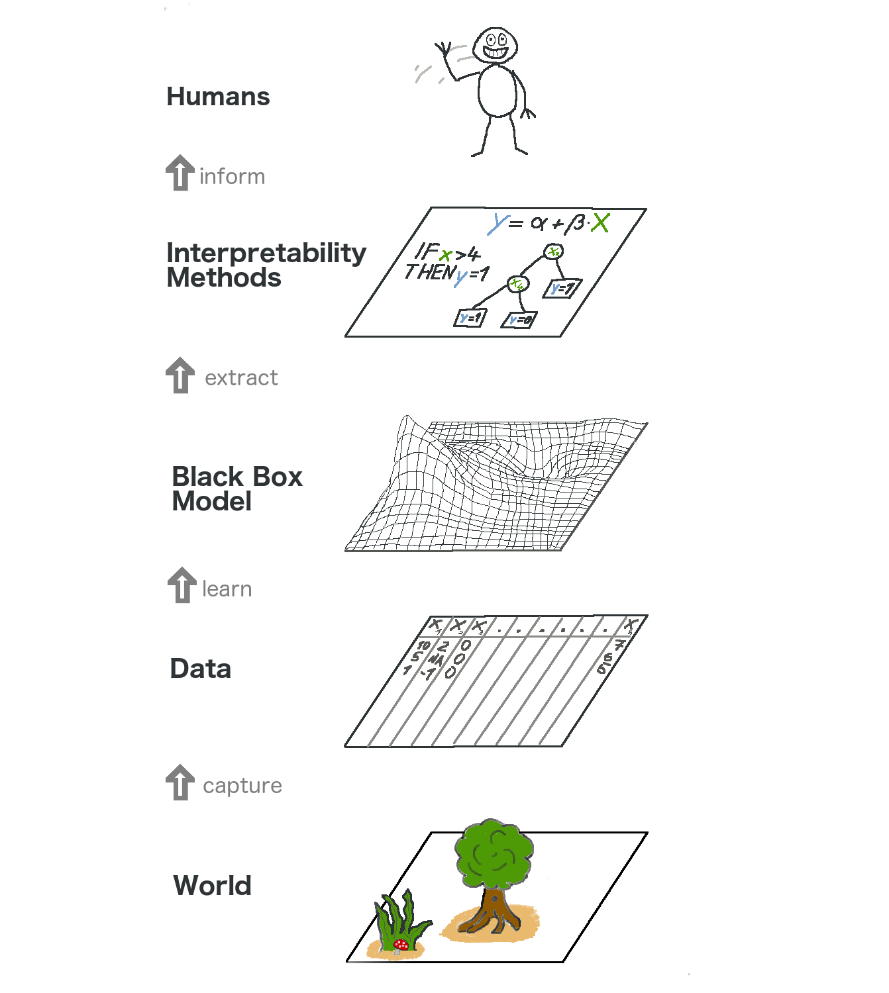
Model Agnostic Explainability Landscape
World layer
It contains everything that can be observed and is of interest.
Data layer
It contains anything from images, texts, tabular data and so on.
Black Box Model layer
Machine learning algorithms learn with data from the real world to make predictions or find structures.
Explainability Methods Layer
It helps us deal with the opacity of machine learning models. What were the most important features for a particular diagnosis? Why was a financial transaction classified as fraud?
Human layer
Humans are ultimately the consumers of the explanations.
Source: Interpretable Machine Learning: A Guide for Making Black Box Models Explainable by Christoph Molnar.

Slide 4
LIME

Slide 5
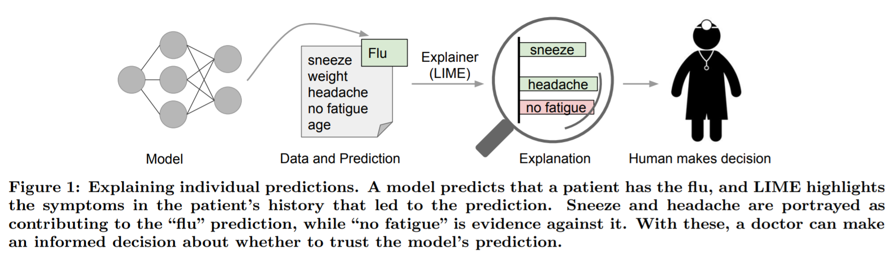
Local Surrogate Model-Agnostic Explanations
LIME is used to explain individual predictions of black box machine learning models¹.
Characteristics of LIME²
Interpretable: Explanations use a representation that is understandable to humans, regardless of the actual features used by the model.
Local Fidelity: Provides a good approximation of the machine learning model predictions locally.
Model Agnostic: Able to explain any model.
1 : Interpretable Machine Learning: A Guide for Making Black Box Models Explainable by Christoph Molnar.
2: Ribeiro, Marco Tulio, Sameer Singh, and Carlos Guestrin. "Why should I trust you?: Explaining the predictions of any classifier." Proceedings of the 22nd ACM SIGKDD international conference on knowledge discovery and data mining. ACM (2016)

Slide 6
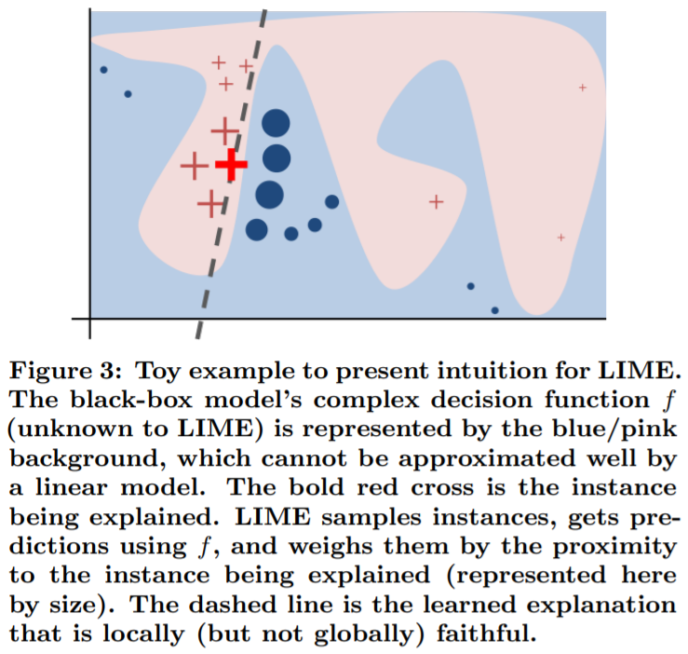

LIME : Process
The recipe for training local surrogate models:
Select your instance of interest
Perturb your dataset and get the black box predictions for these new points.
Weight the new samples according to their proximity to the instance of interest.
Train a weighted, interpretable model on the dataset with the variations
Explain the prediction by interpreting the local model.
Mathematically, local surrogate models with interpretability constraint can be expressed as follows:

Slide 7
SHAP

Slide 8
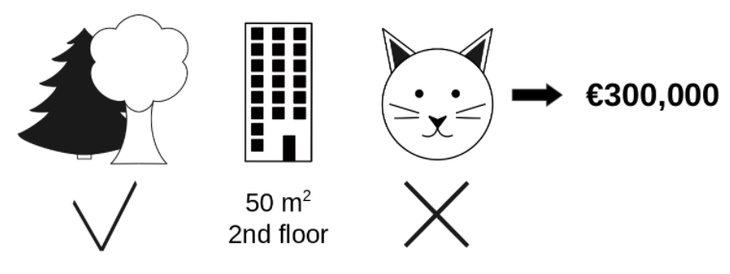
Shapley Values
Shapley value is the average marginal contribution of a feature value across all possible coalitions.
It gives the contribution of each feature to the prediction as compared to the average prediction.
Park nearby (€30,000) +
area 50 square m (€10,000) +
floor 2nd (€0) +
Cat-banned (-€50,000) +
average prediction (€310,000) = actual prediction (€300,000)
Disadvantages
Explanations created with the Shapley value method always use all the features.
Shapley value cannot be used to make statements about changes in prediction for changes in the input, such as: "If I were to earn €300 more a year, my credit score would increase by 5 points.".

Slide 9
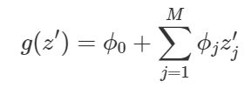
SHAP (SHapley Additive exPlanations)
The goal of SHAP is to explain the prediction of an instance x by computing the contribution of each feature to the prediction.
One innovation that SHAP brings to the table is that the Shapley value explanation is represented as an additive feature attribution method, a linear model.
SHAP specifies the explanation as:
g is the explanation model, z′ is the coalition vector and ϕj is the feature attribution for a feature j, the Shapley values.
Missingness: Missingness says that a missing feature gets an attribution of zero.

Slide 10
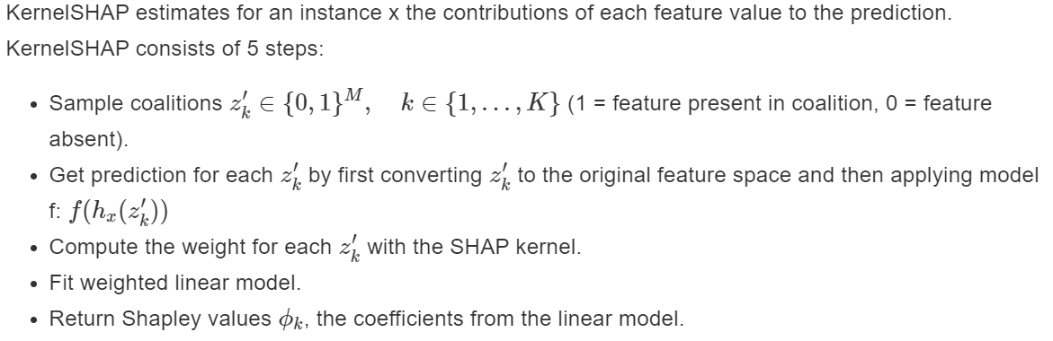
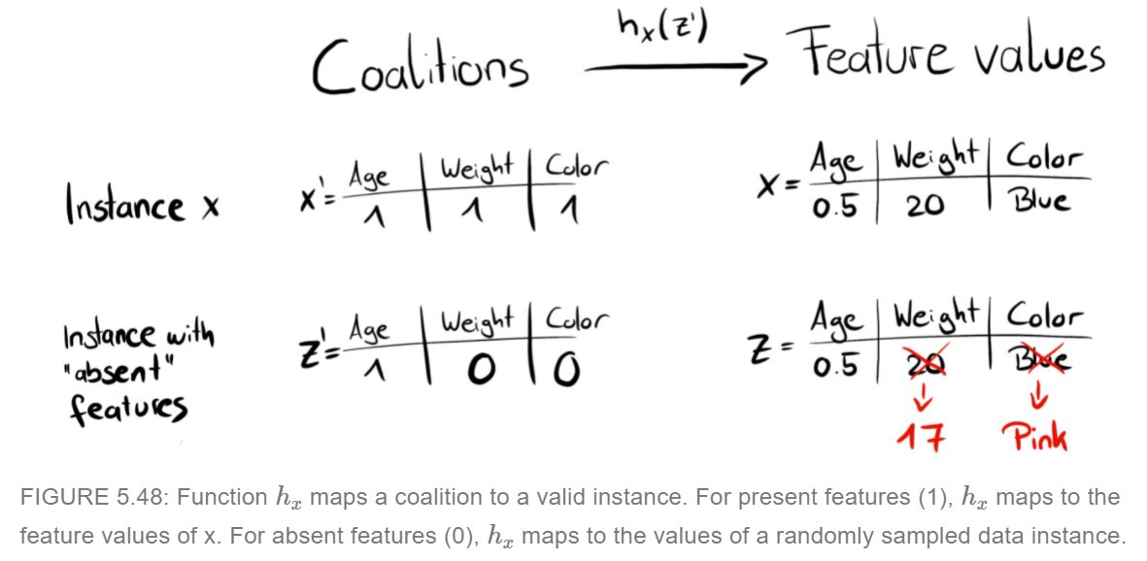
Kernel SHAP

Slide 11
References
Interpretable Machine Learning: A Guide for Making Black Box Models Explainable by Christoph Molnar
Ribeiro, Marco Tulio, Sameer Singh, and Carlos Guestrin. "Why should I trust you?: Explaining the predictions of any classifier." Proceedings of the 22nd ACM SIGKDD international conference on knowledge discovery and data mining. ACM (2016)
Lundberg, Scott M., and Su-In Lee. "A unified approach to interpreting model predictions." Advances in Neural Information Processing Systems. 2017
https://github.com/interpretml/interpret
"Why Should I Trust you?" Explaining the Predictions of Any Classifier: https://www.youtube.com/watch?v=KP7-JtFMLo4

Slide 12


Slide 13


Slide 14


